Slide 1

Capstone Project
Diabetes Prediction
Ruth Caswell Smith
December 1, 2020

Slide 2
Context
Can a classifier be developed which can predict diabetes with reasonable accuracy given a set of risk factors?

Slide 3
Key Findings
A random forest classifier was optimized to give the best recall score with reasonable accuracy.
Top risk factors were determined to be glucose, skin thickness, and age.
BMI was also a strong predictor although it was categorized for the model.

Slide 4
Dataset Overview
Nearly 800 instances
Some missing values (lots for two features)
Some extreme outliers
Some collinearity among features
Every attribute was statistically correlated with target
Dataset was imbalanced

Slide 5
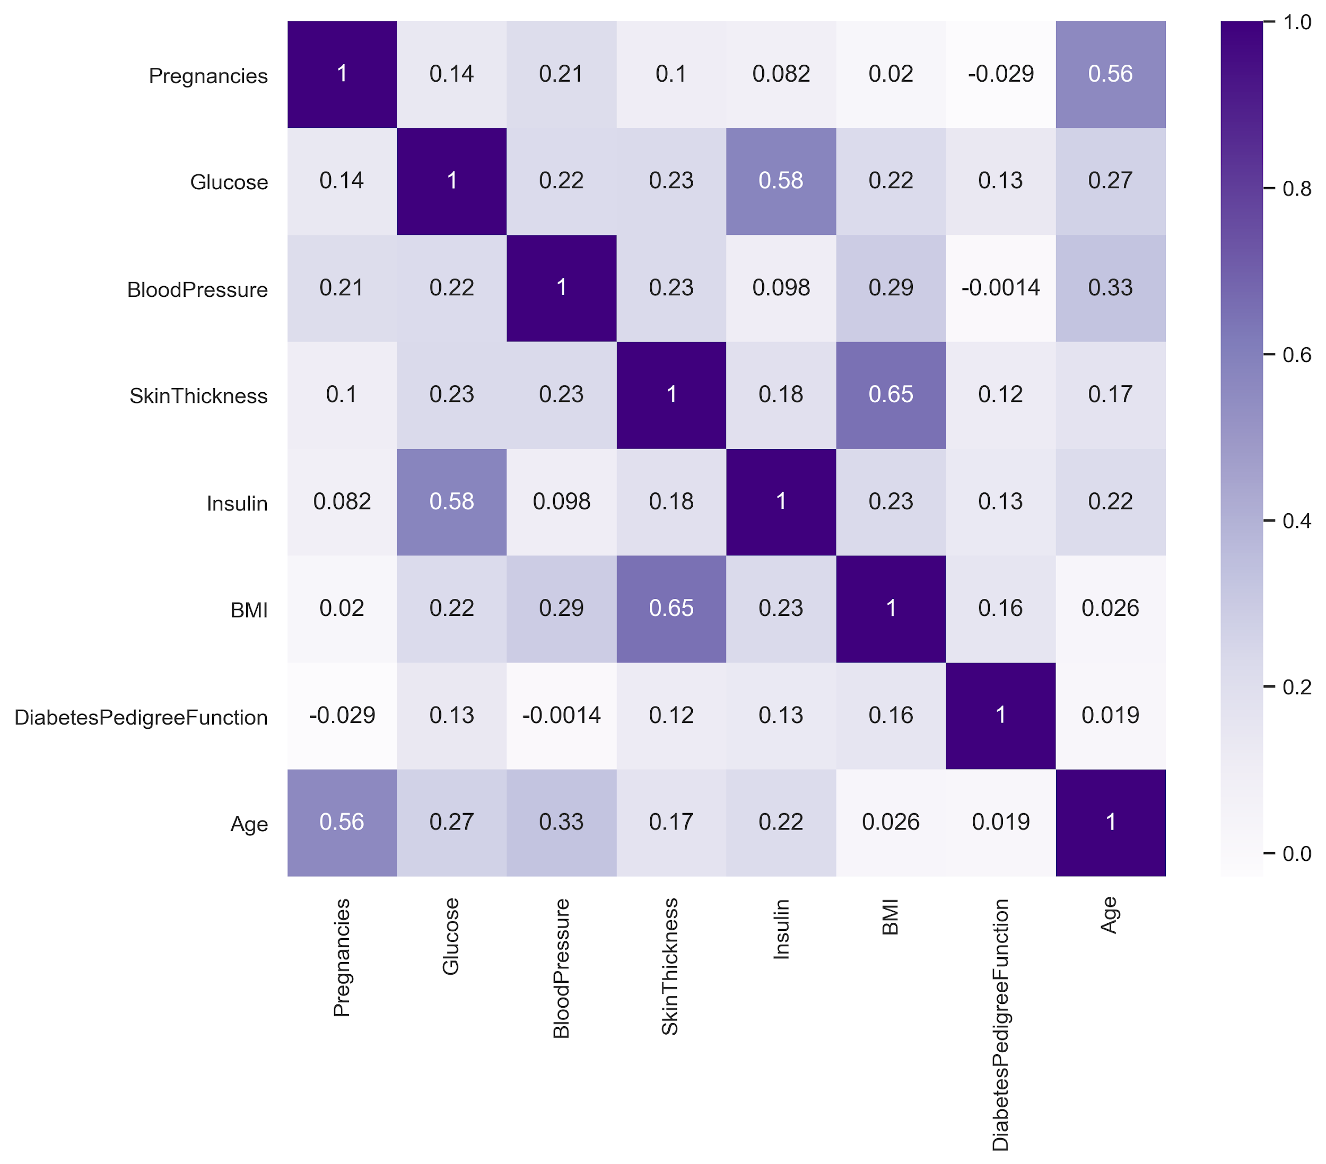
Heatmap

Slide 6
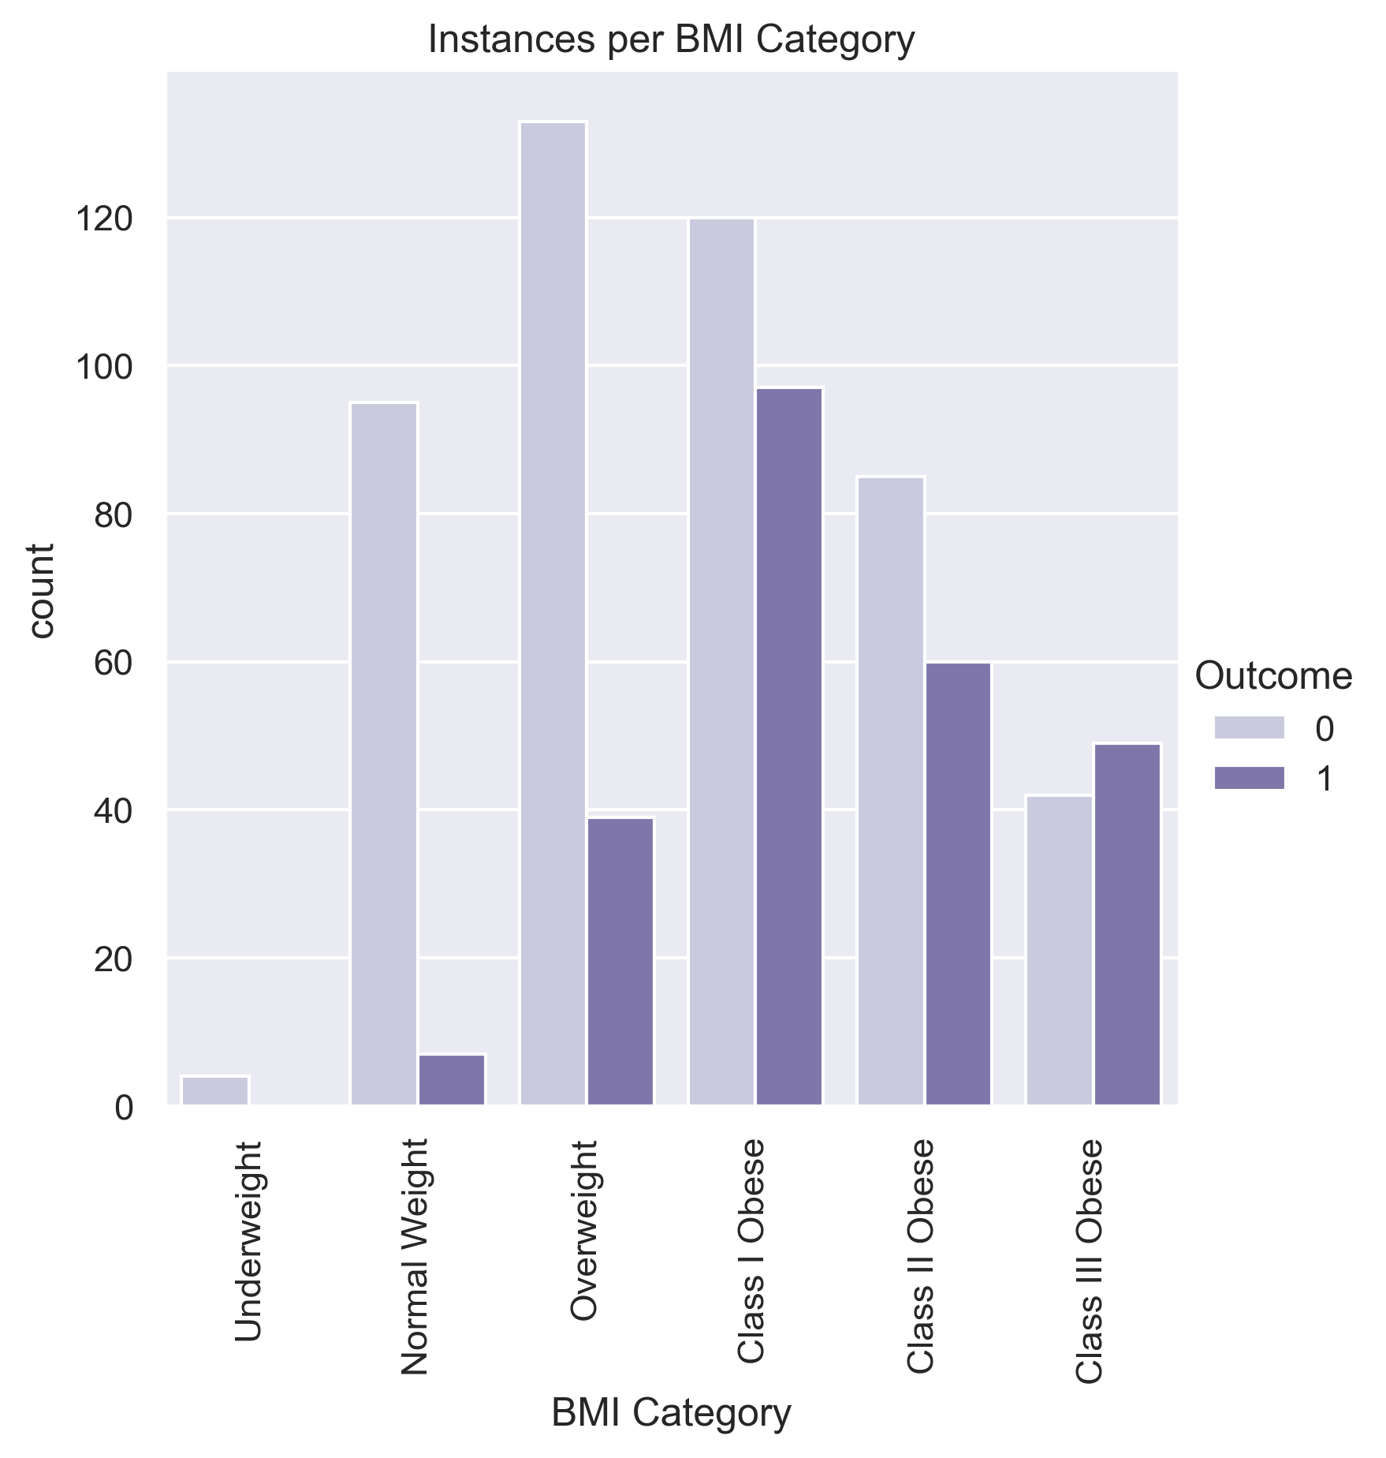
BMI Categorization

Slide 7
Preprocessing
One-hot-encoding
Scaling
Imputation
SMOTE
Feature Selection

Slide 8
Scoring Metrics
Overall Accuracy
# correct / total
Recall Score
# true pos / (# true pos + # false neg)
Confusion matrix
Shows all true/false positives and negatives

Slide 9
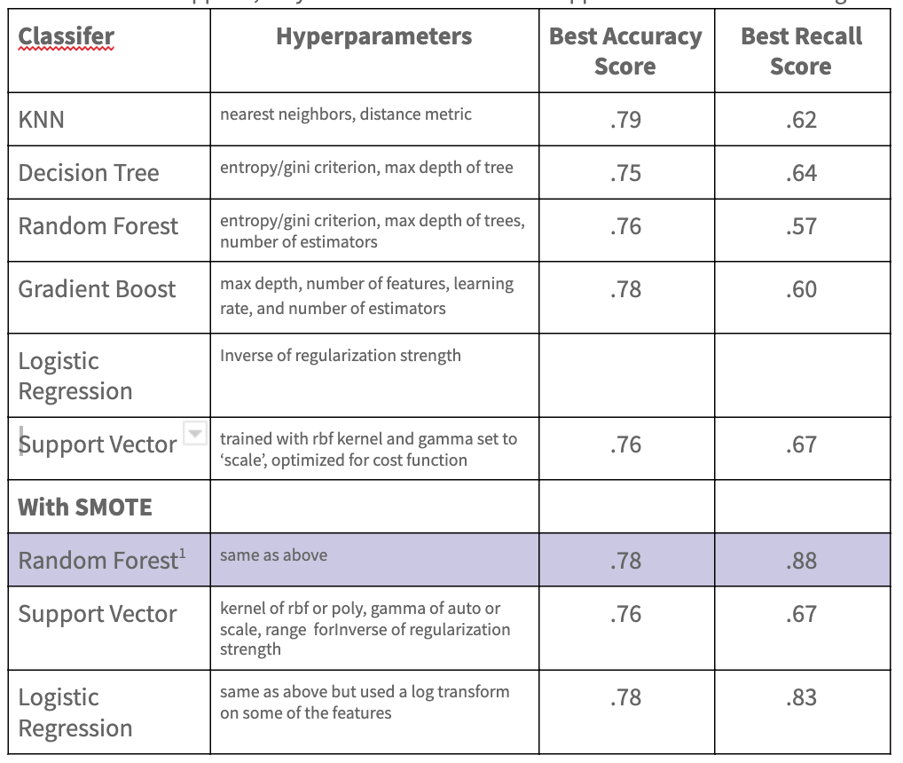
Model Candidates

Slide 10
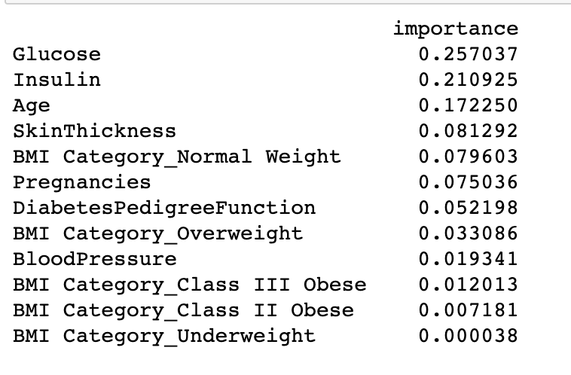
Top Risk Factors

Slide 11
Model Advantages
Quick to train on new data
Quick to predict
No need for scaling
Robust to outliers
dvantages

Slide 12
Summary
The random forest classifier developed is successful at predicting diabetes given several risk factors.
Further investigation can be done to further optimize classification and minimize false negatives.

